Slide 1

Coding in Physics
Some essential examples

Slide 2

Link to files
https://bit.ly/ttu_grades_github

Slide 3
Overview
Monte Carlo
Radiation Penetration
Differential Equation Solver
Runge-Kutta

Slide 4

Setting Up your environment

Slide 5
Setting up your environment
Python
Download the Python extension in the VS Code browser.
C++
https://www.freecodecamp.org/news/how-to-install-c-and-cpp-compiler-on-windows/
Fortran
https://fortran-lang.org/learn/os_setup/install_gfortran/

Slide 6
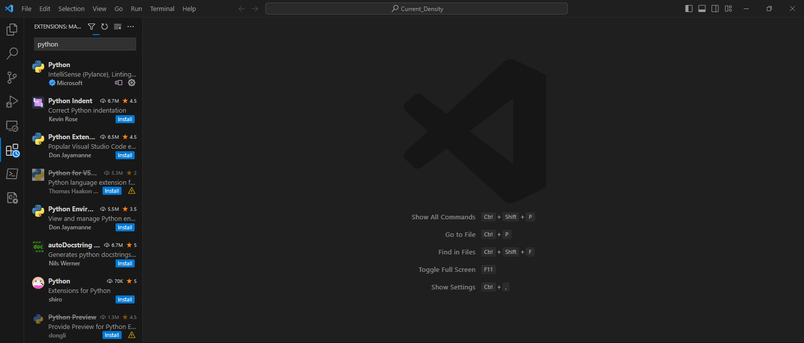
Python

Slide 7
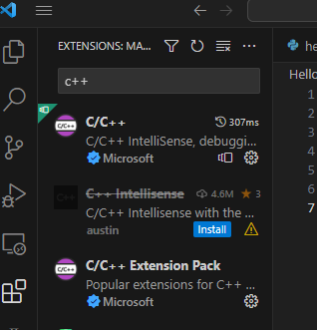
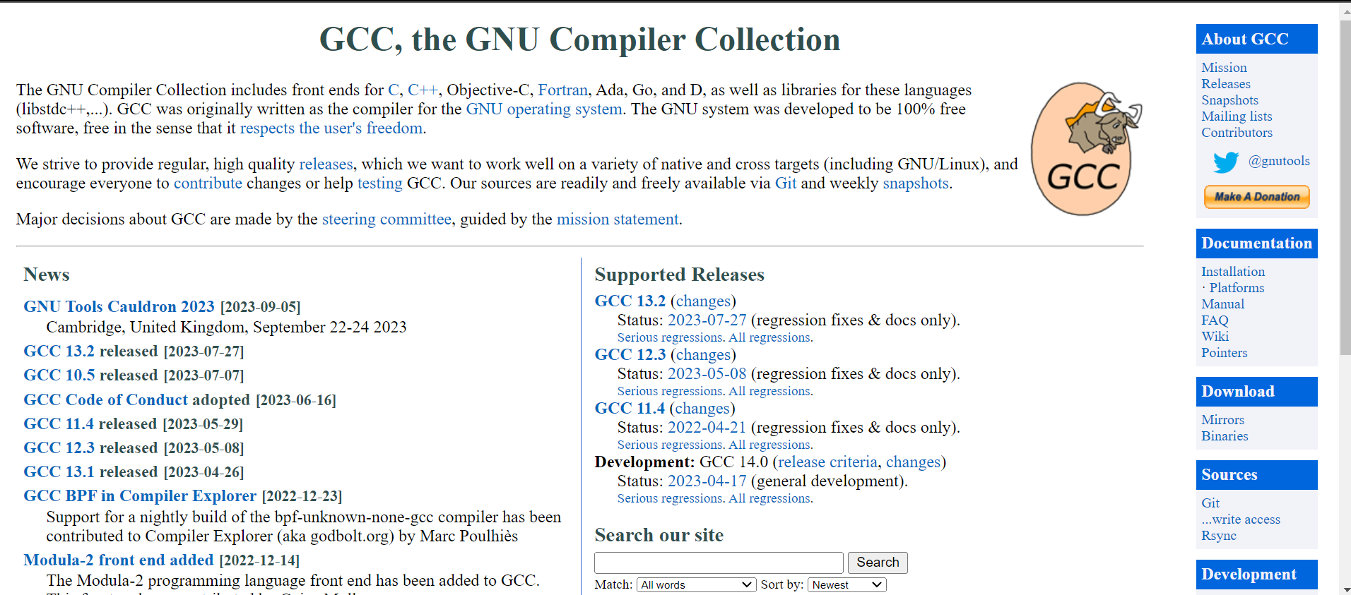
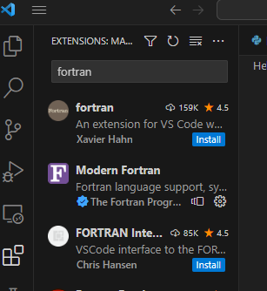
C++ and Fortran

Slide 8
Hello world
Check that your environment works
Go to the next slide that has a copy of the process for the code you chose

Slide 9
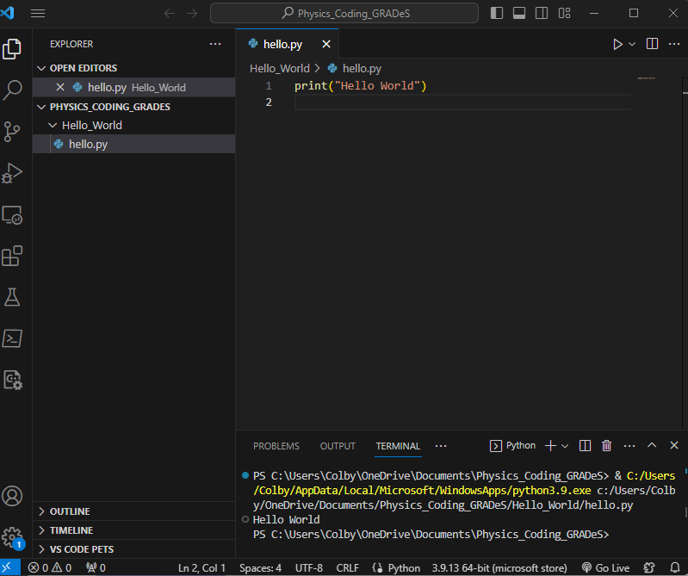
Hello world python
1
Create a file called hello.py
2
print(“Hello World”)
3
Click the run button that came with the python extension.

Slide 10
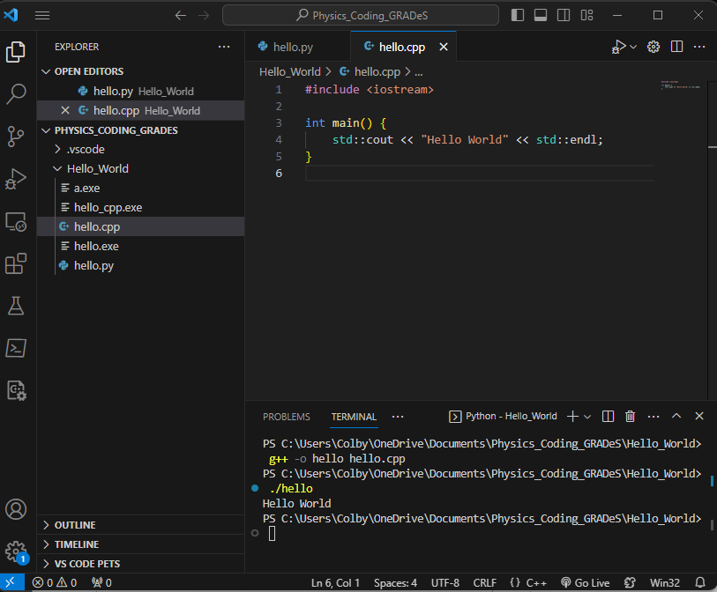
Hello World c++
1
Create a file called hello.cpp
2
Include the iostream
3
Print in the main loop.
4
Compile using g++ -o hello hello.cpp
5
Run using ./hello

Slide 11
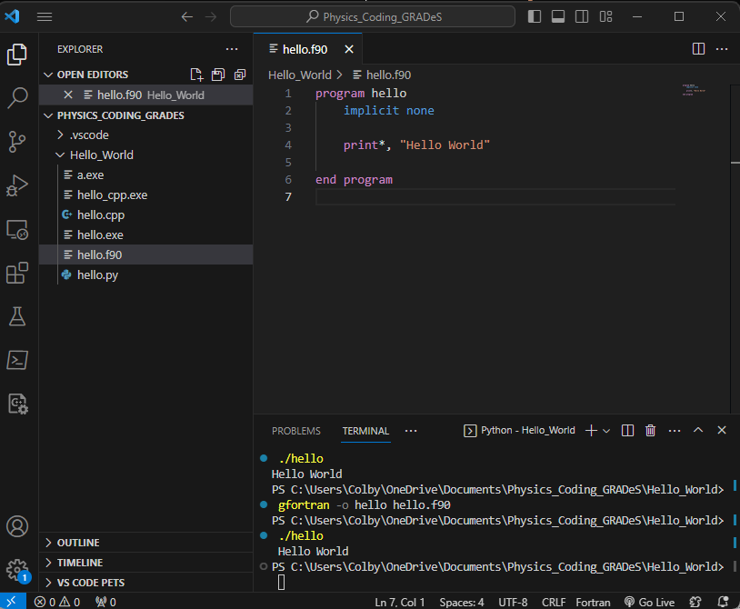
Hello World Fortran
1
Create a file called hello.f90
2
Add the program wrapper and implicit none
3
print*, “Hello World”
4
Compile with gfortran –o hello hello.f90
5
Run with ./hello

Slide 12
Monte Carlo
A particle is incident on a material of thickness L.
Upon hitting the material, the particle has equal probability to bounce in any direction (2-d for this case).
It will then travel a distance d before bouncing in another random direction.
The particle can only do N bounces before it loses all of its energy.
Determine the percentage of incident particles that makes it through the material.

Slide 13
Pseudocode
Create a particle x position at zero.
Create a loop that breaks on three conditions:
Condition 1: The particles exits the material from the entrance side.
Condition 2: The particle completes the maximum number of steps.
Condition 3: The particle travels all through the material.
Generate a random angle between 0 and 2 pi.
Travel the particle the associated horizontal distance and update the particles position.
Repeat the above process for a large number of particles.
Record the percentage of particles that escape the material vs the total particles.

Slide 14
Differential equation solver

